Slide 1
CSC – 183 Programming C
Chapter - 3
Operators and Expressions

Slide 2
Today’s Outline:
C operators
Operator Precedence & Associativity
C Expression Evaluation
Type Conversion in Expressions

Slide 3
C Operators
An operator is a symbol that tells the computer to perform certain mathematical or logical manipulations.
Operators used in programs to manipulate data & variables.
C is very rich in built-in operators, classified into following number of categories:
Arithmetic
Relational
Logical
Assignment
Increment/Decrement
Conditional
Bitwise
Special

Slide 4
C Operators – Arithmetic Operators
Following table lists C’s arithmetic operators:
Integer division(/) truncates any fractional part (remainder).
Modulus operator (%) can not used be used on floating-point data. During modulus operation, sign of the result is always the sign of the first operand.
Example:
- 11 % 2 = - 1
- 11 % 2 = - 1
OPERAND: 11 % 2 = REMAINDER: 1
Operator | Meaning
+ | Addition or unary plus
- | Subtraction or unary minus
* | Multiplication
/ | Division
% | Modulus

Slide 5
C Operators – Arithmetic Operators (Cont.)
Application of modulus operator
From total days find out months and rest days.
total_days = 66 days.
= 2 months and 6 days
Find out a number is odd or even by checking its reminder.
Determine a number is divided by a specific number.
If(6%3==0){printf(“even number”);}
Exercise (Home work):
Write a program, it takes days as input and determine numbers of years, months, weeks and rest days.

Slide 6
C Operators – Relational Operators
Sometimes need to compare two quantities, depending on their relation, to take certain decisions.
These comparisons can be done with the help of relational operators.
Compare: age of two persons, value of two number.
Expressions that use relational operators return 0 for false & 1 for true.
Example: marks > 89 , 10<20 is true, 20<10 is false
Operator | Meaning
> | Is greater than
>= | Is greater than or equal to
< | Is less than
<= | Is less than or equal to
== | Is equal to
!= | Is not equal to

Slide 7
C Operators – Relational Operators
Exercise:
4.5 <= 10 ?
4.5 < -10 ?
-35 >= 0 ?
10 < (7+5) ?
(a+b) < (c+d) ?
a=0 b = 6 c= 5 d = 2
6 < 7 NO
4.5 <= 10 TRUE
4.5 < -10 FALSE
-35 >= 0 FALSE
10 < (7+5) TRUE
(a+b) < (c+d) ? (depends on value of a,b,c,d)

Slide 8
C Operators – Relational Operators (Program)
To find out the large number between two number:
#include<stdio.h>
Int main()
{
int num1,num2;
num1 = 25;
num2 = 20;
if(num1 > num2)
{
printf(“num1 is large”);
}
else
{
printf(“num2 is large”);
}
return 0;
}

Slide 9
C Operators – Logical Operators
Logical refers to the ways relationships can be connected.
Used when need more than one condition to take decision.
Expressions that use logical operators return 0 for false & 1 for true.
The truth table for logical operators is shown below:
Some examples:
To check age between 18 to 30
if( age > 18 && age<30 ) allow to apply for job
To check Grade:
if( marks > 0 && marks < 60) then Grade is F
Operator | Meaning
&& | AND
|| | OR
! | NOT
P | Q | P && Q | P || Q | !P
0 | 0 | 0 | 0 | 1
0 | 1 | 0 | 1 | 1
1 | 1 | 1 | 1 | 0
1 | 0 | 0 | 1 | 0

Slide 10
Leap Year Program: using logical opeators
#include<stdio.h>
int main()
{
int year;
printf("Enter a year: ");
scanf("%d",&year);
if((year%4 == 0) && (year%100 != 0) || (year%400 == 0))
{
printf("\n%d is a leap year",year);
}
else
{
printf("\n%d is not a leap year",year);
}
return 0;
}

Slide 11
C Operators – Assignment Operator
‘=‘ used to assign the result of an expression to a variable. General form: variable_name = expression; c = a+b
Multiple assignments: x = y = z = 0;
Compound assignments: The statement of the form var = var operator expression can be written as var operator = expression
e.g. x = x + 1 can written as x += 1
It also called shorthand assignment operator.
Operator
+=
-=
*=
/=
%=
Operator | Example
X=X+1 | X += 1
X=X-1 | X -= 1
X=X*Y | X *= Y
X=X/Y | X /= Y
X=X%Y | X %= Y

Slide 12
C Operators – Increment/Decrement
‘ ++ ’ adds 1 to its operand and ‘ -- ’ subtracts 1 from its operand.
x = x +1 is same as ++x or x++ and x=x -1 same as --x or x--
Both the increment and decrement operator may either in prefix or postfix form.
When postfix (x++ or x--) is used with a variable in an expression, the expression is evaluated first using the original value of the variable and then the variable is incremented (or decremented) by one. i.e
m = 5; y = m++;
m = ? y = ?
Result: m = 6; y= 5
When prefix (++x or --x) is used in an expression, the variable is incremented (or decremented) first and then the expression is evaluated using new value of the variable.
m = 5; y = ++m;
m = ? y = ?
Result: m = 6 ; y = 6

Slide 13
C Operators – Conditional Operator
Also called ternary operator “ ?: ”
General form: exp1 ? exp2 : exp3
exp1, exp2, exp3 are expression. i.e. a + b, a < b, a == b
Operation same as if-then-else statement
a = 10;
b = 15;
x = ( a > b) ? a : b;
if (a > b)
x = a;
else
x = b;

Slide 14
C Operators – Bitwise Operators
To manipulate data bit level, bitwise operators used.
Bitwise operation refers to testing, setting, or shifting the actual bits in a byte or word, which correspond to the standard char or int data types.
Bitwise operator can not be used on float, double, long double or void data types.
Operator | Meaning
& | AND
| | OR
^ | XOR
~ | One’s Complement (NOT)
>> | Shift right
<< | Shift left

Slide 15
C Operators – Special Operators
Comma operator: (,)
Comma operator can be used to link the related expression together.
Ex: int a, b, c; a=1, b=2, c=3;
Sizeof operator: Returns the number of bytes, occupied by operand.
m = sizeof(sum);
i = sizeof(int);
Pointer operator: ( & and * )
Member selection operator: ( . and -> )
Exercise: Example 3.3

Slide 16
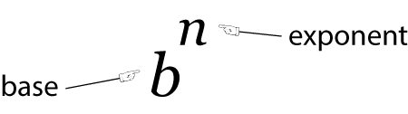
Arithmetic Expressions:
An arithmetic expression is a combination of variables, constants and operators and function calls by maintaining C syntax.
C does not have an operator for exponentiation.
Expression represent in C:
Algebraic expression | C expression
a x b -c | a*b-c
(m+n)(x+y) | (m+n)*(x+y)
3x²+2x+1 | 3*x*x + 2*x + 1
 | x/y+c

Slide 17
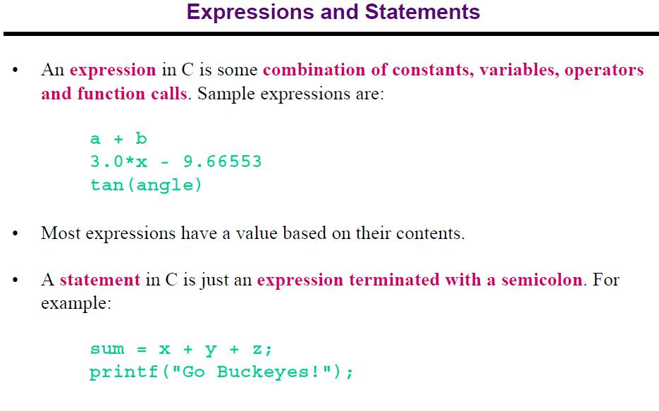

Slide 18
Precedence and Associativity
Precedence: Decides the order in which different operators are evaluates or calculated. Give priority to operators.
x = 9 - 12 / 3 + 3 * 2 - 1
x = 9 - 4 + 3 * 2 - 1
x = 9 - 4 + 6 - 1
x = 5 + 6 - 1
x = 11- 1
x = 10
Associativity: Decide the calculation order of expression when multiple operators have same precedence in an expression. Decides Left to Right or Right to Left evaluation.
x = 3 * 2 * 2 + 5 * 2 (Left to Right)
x = 6 * 2 + 5 * 2
x = 12 + 5 * 2
x = 12+ 10
x = 22

Slide 19
Evaluation of Expressions:
variable = expression;
x = a – b / 3 + c * 2 – 1;
y = a – b / (3 + c) * (2 – 1);
z = a – (b / (3 + c) * 2) – 1;
If a = 9 , b = 12, c = 3; what is value of x, y, z?
x = 10
y = 7
z = 4

Slide 20
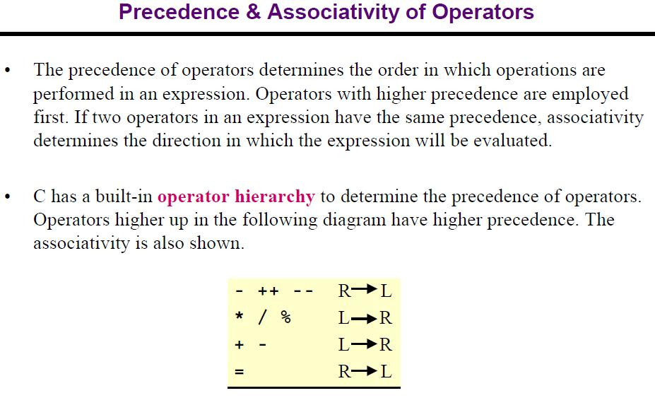

Slide 21
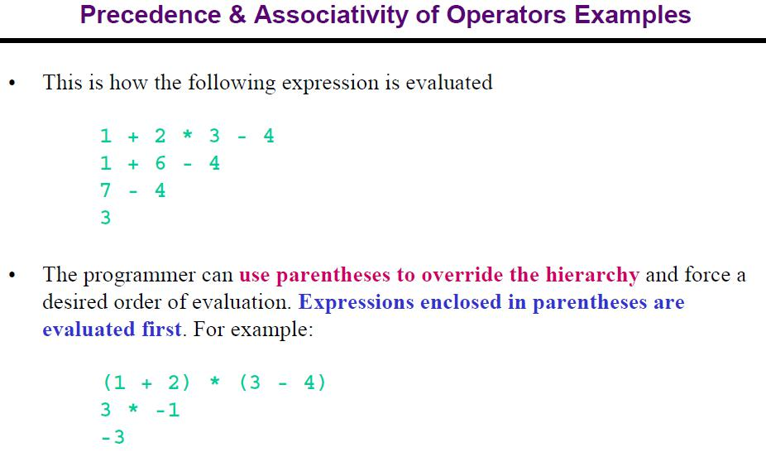

Slide 22
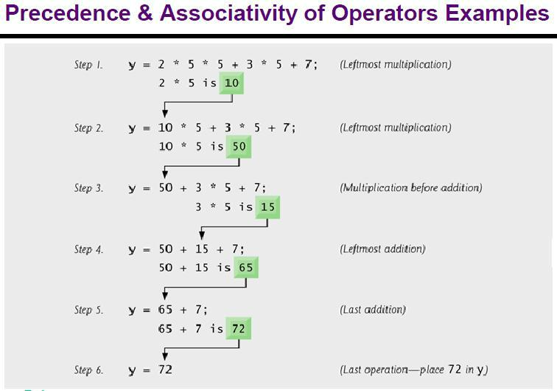

Slide 23
C Type Conversion: Two Types
Implicit type conversion: C automatically converts any intermediate values to the proper type so that the expression can be evaluated without loosing any significance, called implicit type conversion.
Rule: If the operands are of different types, the ‘lower type’ is automatically converted to ‘higher type’ before operation proceeds.
int i,x;
float f;
double d;
x = i * f + d
i automatically converted to float type, then multiplication performs.
Then (i * f) converted to double and add with d.
Then final result will converted to int type, data type of x.

Slide 24
C Type Conversion: Two Types
Explicit type conversion: When we force an expression to be a specific type, called explicit type conversion.
General form: (data_type) expression;
e.g. int x;
float y = 20.0;
x = (int) (y + 10.5);
a = (int) 21.3 / (int)4.5 equivalent to a = 21/4 = 5
x = (int) a + b [a converted to integer and add with b]

Slide 25
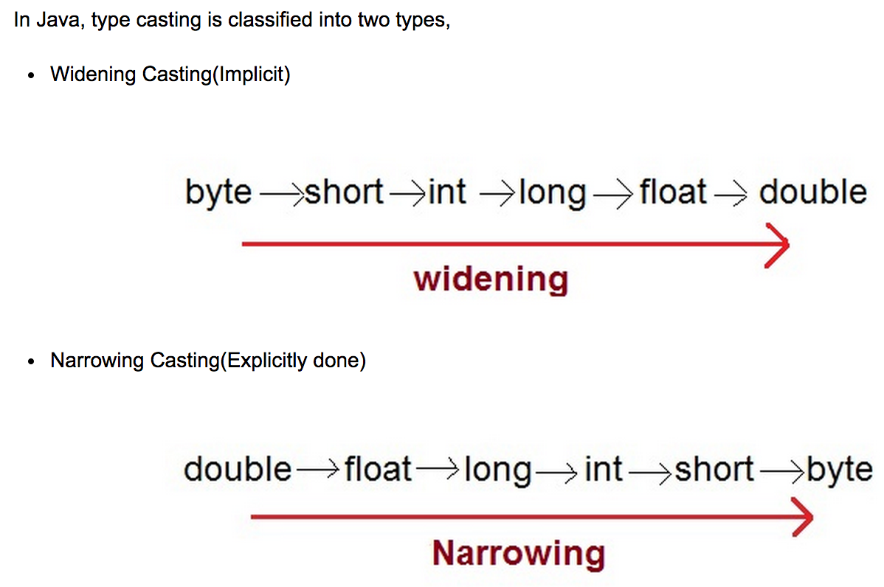

Slide 26
